Slide 1
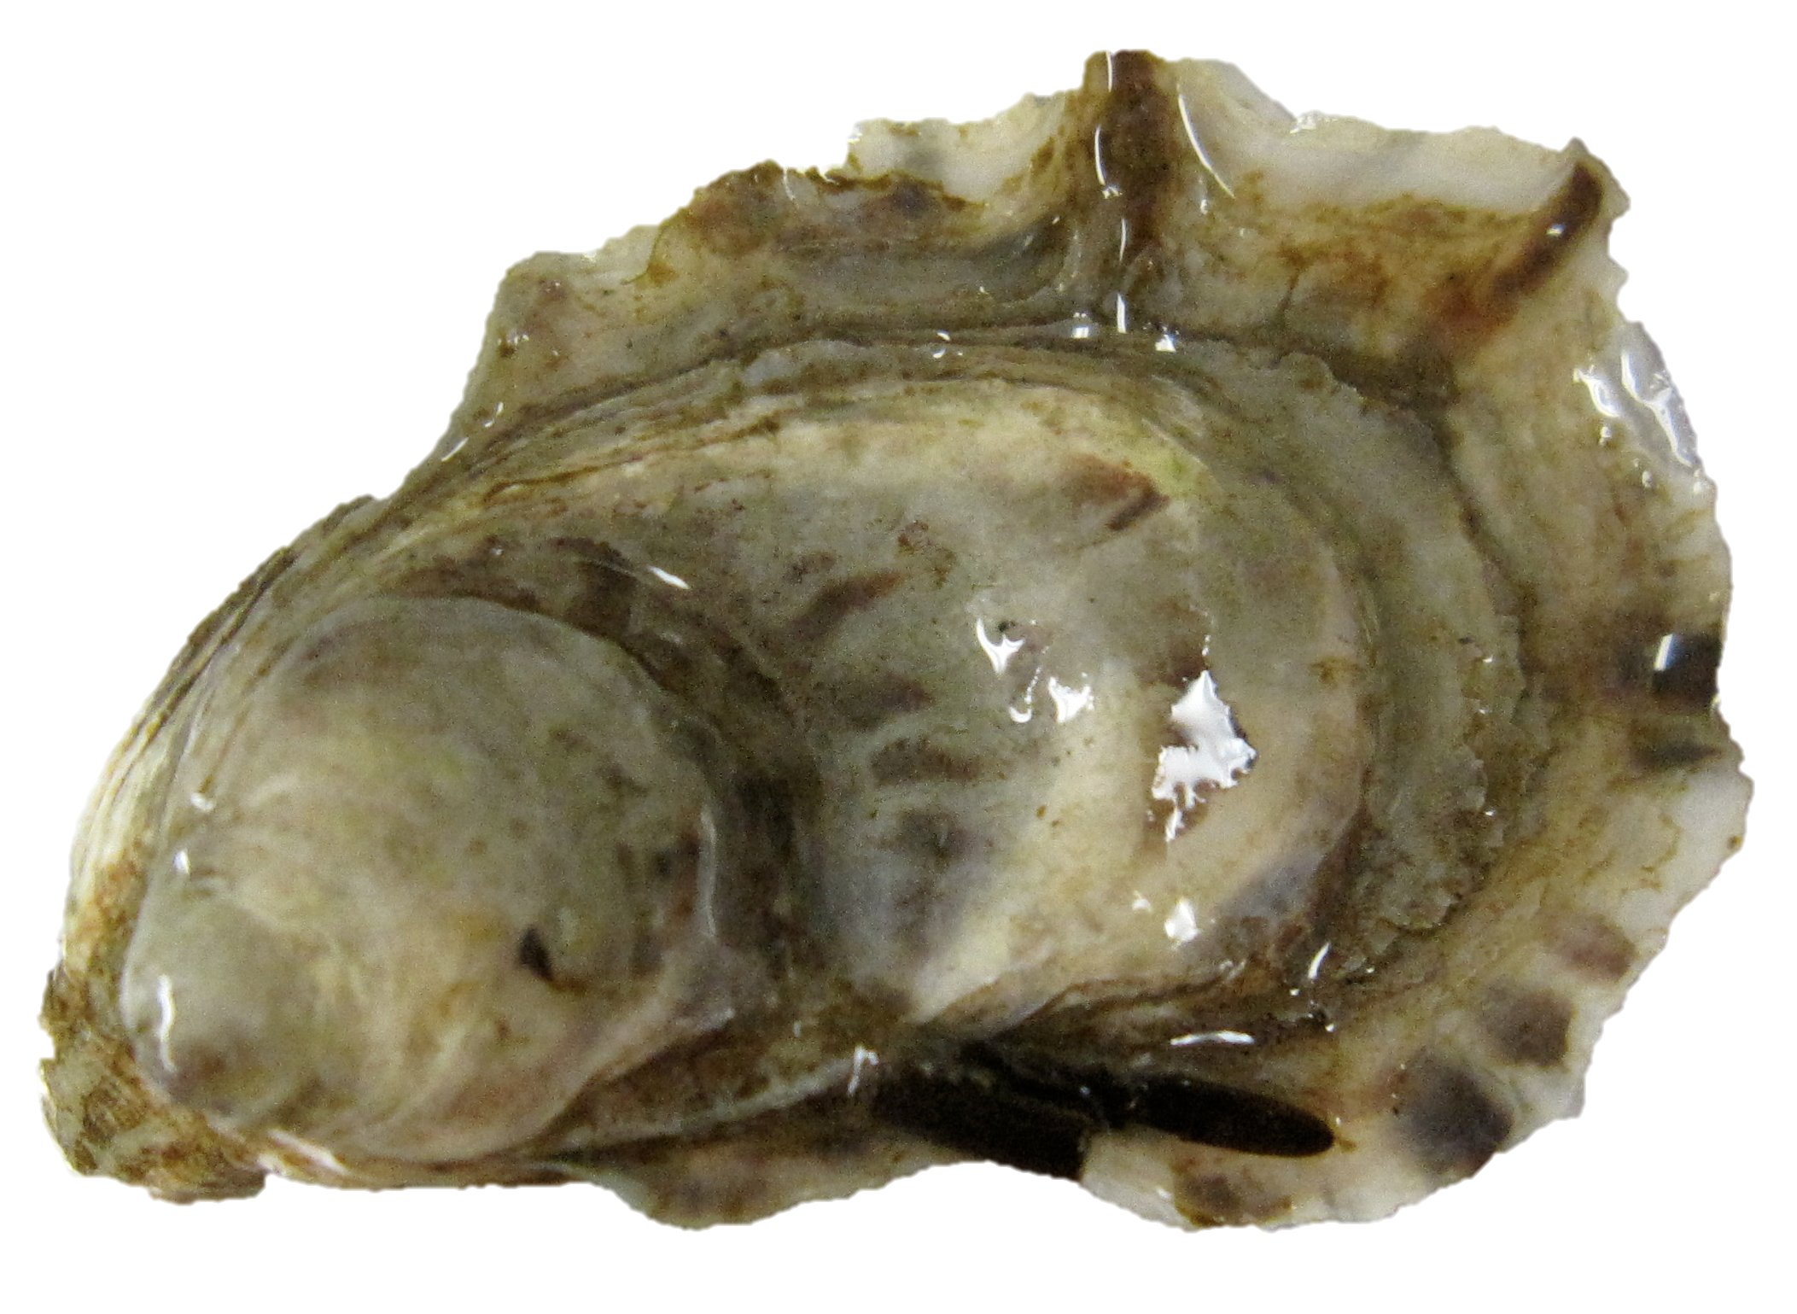
Small proteomic shift
Mechanical stress
OA + Mechanical stress
Proteomic shift
Neuromuscular, cell adhesion & morphogenesis
Carbohydrate metabolism
SYNERGISTIC RESPONSE
Ocean acidification
No effect on response to acute heat shock
No effect on lipid metabolism
Shell structure weakened
Proteomic shift
Cell adhesion & morphogenesis
Oxidative stress
NOT ALL PROCESSES AFFECTED-
physiological trade-offs

Slide 2
1
N-acetylgalactosamine kinase
5
Alpha-mannosidase
2
UDP-N-acetylhexosamine pyrophosphorylase
6
6-phosphogluconolactonase
3
Phosphoacetylglucosamine mutase
7
Succinyl-CoA ligase subunit B, mitochondrial
4
UDP-glucose 4-epimerase
ATP
8
Alpha-L-fucosidase
Galactose
N-acetyl-D-galactosamine
1
N-acetyl-alpha-D-galactosamine 1-phosphate
2
UTP
UDP-galactose
UDP-N-acetyl-alpha-D-galactosamine
4
UDP-glucose
4
UTP
Glucose
N-acetyl-alpha-D-glucosamine 1-phosphate
2
UDP-N-acetyl-alpha-D-glucosamine
3
N-acetyl-alpha-D-glucosamine 6-phosphate
6
Glucose-6-phosphate
6-phosphoglucono-delta-lactone
6-phosphogluconate
5
Fructose-6-phosphate
Mannose
Mannan
6-phospho-D-gluconate
Fucose
Alpha-L-fucoside
8
L-fucose
TCA (7)
Notes:
Overall carbohydrate metabolism pathway(s) and enzymes that are >5-fold different across 3 treatment comparisons. Unless an enzyme is indicated, blue arrows may represent more than one step from a compound to another.

Slide 3
1
N-acetylgalactosamine kinase
8
Alpha-mannosidase
Beta-D-xylocidase 5
2
UDP-N-acetylhexosamine pyrophosphorylase
7
6-phosphogluconolactonase
4
Phosphoacetylglucosamine mutase
10
Succinyl-CoA ligase subunit B, mitochondrial
3
UDP-glucose 4-epimerase
ATP
9
Alpha-L-fucosidase
Galactose
N-acetyl-D-galactosamine
1
N-acetyl-alpha-D-galactosamine 1-phosphate
2
UTP
UDP-galactose
6
UDP-N-acetyl-alpha-D-galactosamine
3
UDP-glucose
5
Glycogen
3
UTP
Glucose
N-acetyl-alpha-D-glucosamine 1-phosphate
2
UDP-N-acetyl-alpha-D-glucosamine
4
N-acetyl-alpha-D-glucosamine 6-phosphate
7
Glucose-6-phosphate
6-phosphoglucono-delta-lactone
6-phosphogluconate
8
Fructose-6-phosphate
Mannose
Mannan
6-phospho-D-gluconate
Fucose
Alpha-L-fucoside
9
L-fucose
TCA (10)
Notes:
OA response - >5-fold carb metabolism proteins

Slide 4
8
Serine/threonine-protein phosphatase PP1-beta catalytic subunit
1
N-acetylgalactosamine kinase
Alpha-mannosidase
2
UDP-N-acetylhexosamine pyrophosphorylase
7
6-phosphogluconolactonase
4
Phosphoacetylglucosamine mutase
10
Succinyl-CoA ligase subunit B, mitochondrial
3
UDP-glucose 4-epimerase
ATP
9
Alpha-L-fucosidase
Beta-D-xylocidase 5
Galactose
N-acetyl-D-galactosamine
1
N-acetyl-alpha-D-galactosamine 1-phosphate
2
UTP
UDP-galactose
6
UDP-N-acetyl-alpha-D-galactosamine
3
UDP-glucose
5
Glycogen
3
UTP
Glucose
N-acetyl-alpha-D-glucosamine 1-phosphate
2
UDP-N-acetyl-alpha-D-glucosamine
4
N-acetyl-alpha-D-glucosamine 6-phosphate
7
Glucose-6-phosphate
6-phosphoglucono-delta-lactone
6-phosphogluconate
8
Fructose-6-phosphate
Mannose
Mannan
6-phospho-D-gluconate
Fucose
Alpha-L-fucoside
9
L-fucose
TCA (10)
Notes:
Mech stress at 400 µatm

Slide 5
1
N-acetylgalactosamine kinase
8
Alpha-mannosidase
5
Glycogen synthase
2
UDP-N-acetylhexosamine pyrophosphorylase
7
6-phosphogluconolactonase
6
Glycogenin-1
4
Phosphoacetylglucosamine mutase
10
Succinyl-CoA ligase subunit B, mitochondrial
3
UDP-glucose 4-epimerase
ATP
9
Alpha-L-fucosidase
Galactose
N-acetyl-D-galactosamine
1
N-acetyl-alpha-D-galactosamine 1-phosphate
2
UTP
UDP-galactose
6
UDP-N-acetyl-alpha-D-galactosamine
3
UDP-glucose
5
Glycogen
3
UTP
Glucose
N-acetyl-alpha-D-glucosamine 1-phosphate
2
UDP-N-acetyl-alpha-D-glucosamine
4
N-acetyl-alpha-D-glucosamine 6-phosphate
7
Glucose-6-phosphate
6-phosphoglucono-delta-lactone
6-phosphogluconate
8
Fructose-6-phosphate
Mannose
Mannan
6-phospho-D-gluconate
Fucose
Alpha-L-fucoside
9
L-fucose
TCA (10)

Slide 6
Carbohydrate Metabolism
1
N-acetylgalactosamine kinase
2
UDP-N-acetylhexosamine pyrophosphorylase
3
UDP-glucose 4-epimerase
4
Phosphoacetylglucosamine mutase
8
Ocean Acidification
Mechanical Stress
Alpha-mannosidase
7
6-phosphogluconolactonase
1
2
10
4
10
Succinyl-CoA ligase subunit B, mitochondrial
9
Alpha-L-fucosidase
9
12
3
11
8
5
Glycogen synthase
6
Glycogenin-1
11
Beta-D-xylocidase 5
12
Serine/threonine-protein phosphatase PP1-beta catalytic subunit
Ocean Acidification + Mechanical Stress
6
9
7
1
4
5

Slide 7
Ocean Acidification
Mechanical Stress
1
2
10
4
6
9
7
9
12
1
8
4
3
11
Ocean Acidification + Mechanical Stress
5
Galactose
ATP
N-acetyl-D-galactosamine
1
N-acetyl-alpha-D-galactosamine 1-phosphate
UDP-galactose
2
UTP
6
3
5
UDP-N-acetyl-alpha-D-galactosamine
UDP-glucose
Glycogen
3
UTP
Glucose
N-acetyl-alpha-D-glucosamine 1-phosphate
2
UDP-N-acetyl-alpha-D-glucosamine
4
N-acetyl-alpha-D-glucosamine 6-phosphate
7
Glucose-6-phosphate
6-phosphoglucono-delta-lactone
6-phosphogluconate
8
Fructose-6-phosphate
Mannose
Mannan
6-phospho-D-gluconate
Fucose
Alpha-L-fucoside
9
L-fucose
TCA (10)

